Slide 1
Machine Learning
Session 1

Slide 2
Agenda:
1 | Introduction to Machine Learning
2 | Linear Regression
3 | Polynomial Regression

Slide 3
Introduction to Machine Learning

Slide 4
What is Machine Learning?
Machine Learning is a branch of artificial intelligence (AI) that focuses on building systems that can learn from and make decisions based on data. Instead of being explicitly programmed to perform a task, ML models identify patterns and learn from the data they are provided.

Slide 5
Types of Machine Learning
Supervised Learning: Models are trained on labeled data (i.e., input-output pairs), making predictions based on this training. Examples include classification (e.g., spam detection) and regression (e.g., predicting house prices).
Unsupervised Learning: Models learn from unlabeled data by finding hidden patterns or intrinsic structures in input data. Examples include clustering (e.g., customer segmentation) and association (e.g., market basket analysis).
Reinforcement Learning: Models learn by interacting with an environment and receiving rewards or penalties, like teaching a robot to navigate a maze.

Slide 6
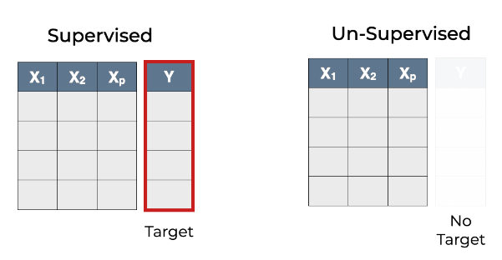
Supervised vs. Unsupervised

Slide 7
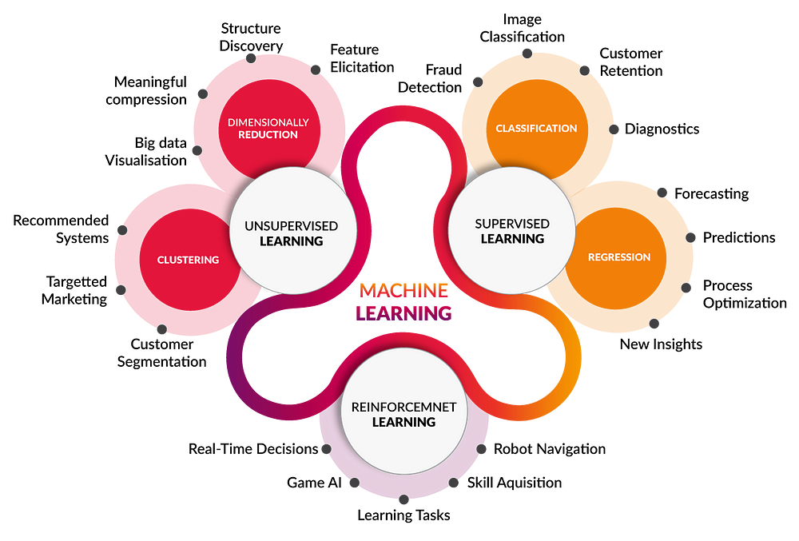
Types of Machine Learning

Slide 8
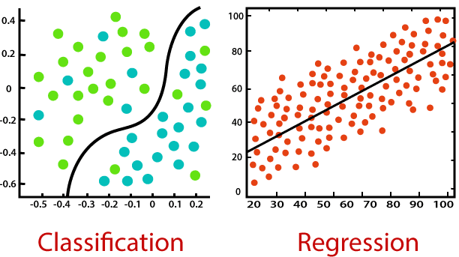
Key Differences
Classification: The goal is to divide data into different categories using a boundary (e.g., identifying spam emails from non-spam emails).
Regression: The goal is to predict continuous numerical values by fitting a line or curve to the data (e.g., predicting house prices).

Slide 9
Linear Regression

Slide 10
Linear Regression
Linear regression is one of the simplest and most commonly used predictive modeling techniques. It models the relationship between a dependent (target) variable and one or more independent (predictor) variables by fitting a linear equation to observed data.

Slide 11
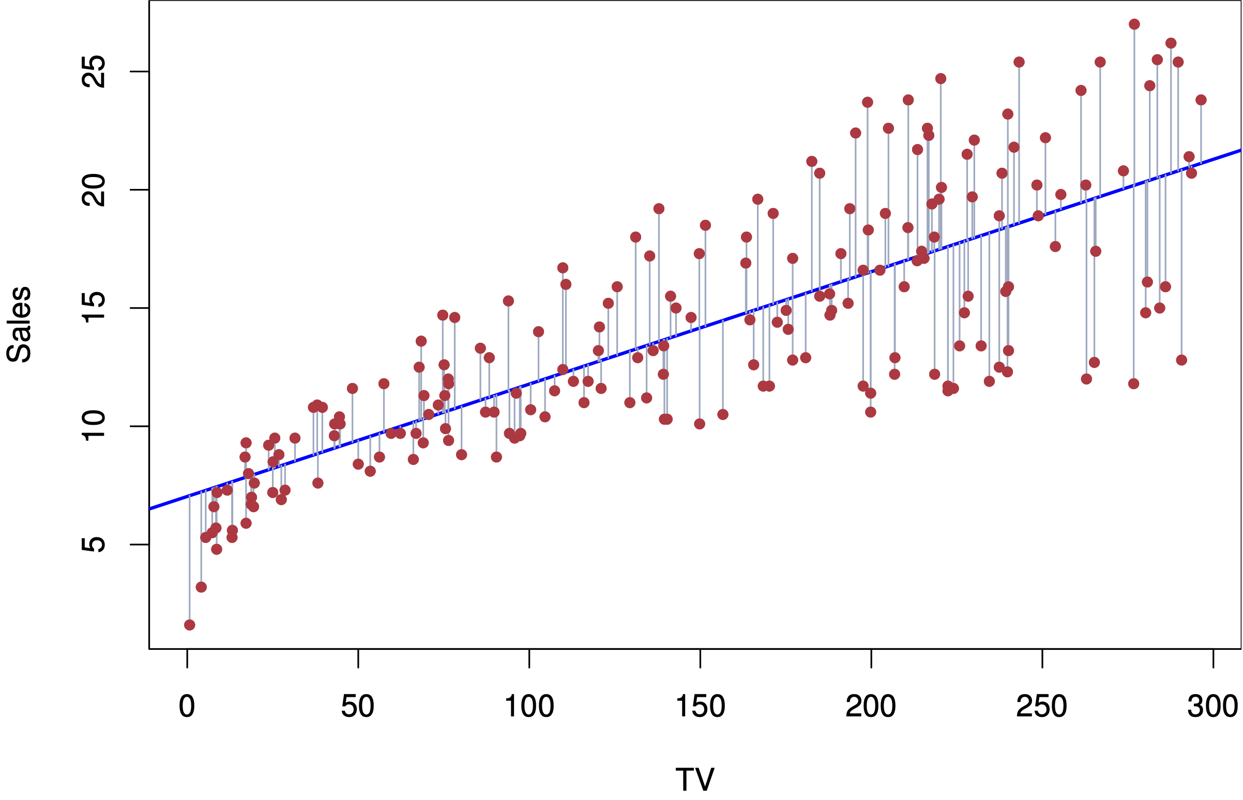
Linear Regression
The objective of linear regression is to identify the line of best fit, known as the regression line, that reduces the difference between the predicted values and the actual data points as much as possible.

Slide 12

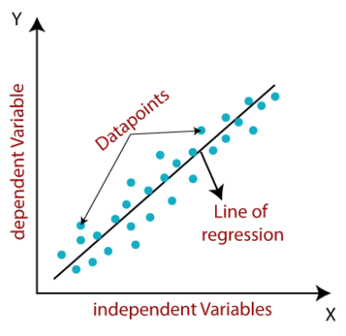
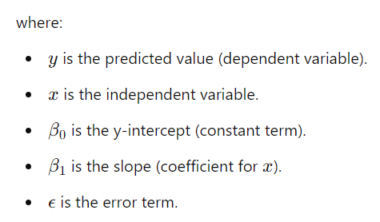
Simple Linear Regression
Simple linear regression uses one independent variable to predict a dependent variable. The relationship is modeled by a straight line

Slide 13

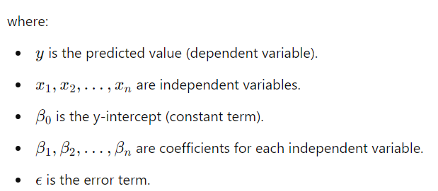
Multiple Linear Regression
Multiple linear regression extends simple linear regression by using two or more independent variables to predict a dependent variable. The equation is

Slide 14
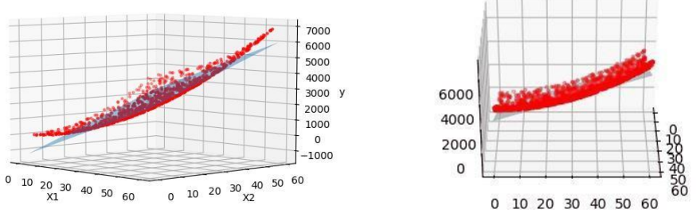
Multiple Linear Regression

Slide 15

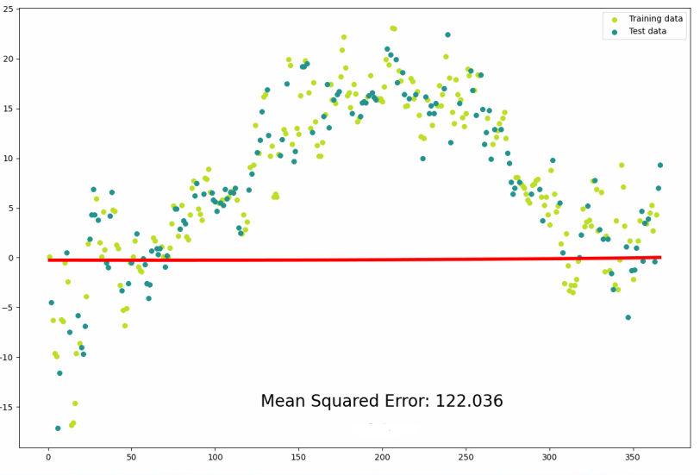
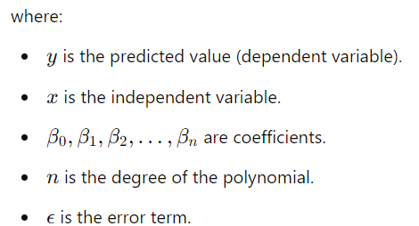
Polynomial Regression
Polynomial regression is a type of regression analysis where the relationship between the independent variable x and the dependent variable y is modeled as an n-degree polynomial. Unlike linear regression, which fits a straight line, polynomial regression fits a curve to the data.

Slide 16
Key Characteristics
1. Linear Model with Modifications
Although polynomial regression includes non-linear terms, the overall model is still considered linear in the parameters, because the coefficients ( , 𝑏1b 1 , etc.) are linear.
These additional terms allow the model to fit curves to the data, improving accuracy when the relationship between the variables is non-linear.
2. Non-Linear Dataset
Polynomial regression is often used for datasets where the relationship between the independent variable (X) and the dependent variable (Y) is non-linear.
In the simple linear regression example, the model fits a straight line, but this does not always capture the true relationship. The polynomial model better fits the data by allowing for curves.

Slide 17
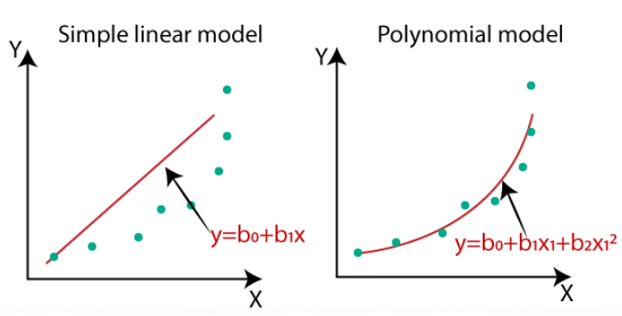
Key Characteristics

Slide 18


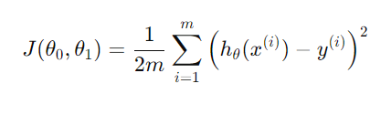
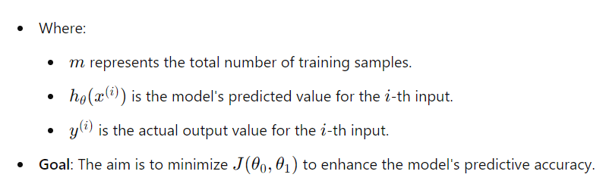
Cost Function
The cost function assesses the performance of the linear regression model by measuring the difference between the predicted values and the actual observed values 𝑦.
Mean Squared Error (MSE):

Slide 19

Different Evaluation Metrics
Mean Squared Error (MSE):
Measures the average of the squared differences between actual and predicted values.
Commonly used because it effectively penalizes larger errors and is simple to calculate.

Slide 20
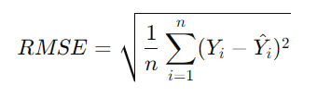
Different Evaluation Metrics
Root Mean Squared Error (RMSE):
The square root of MSE. It represents error in the same units as the original data, making it easier to interpret.

Slide 21
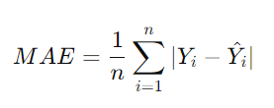
Different Evaluation Metrics
Mean Absolute Error (MAE):
Measures the average absolute difference between the actual and predicted values.
Less sensitive to outliers compared to MSE, providing a more robust evaluation metric.

Slide 22
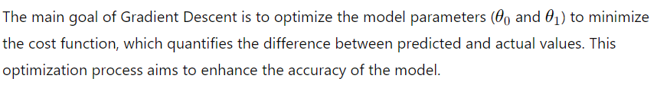
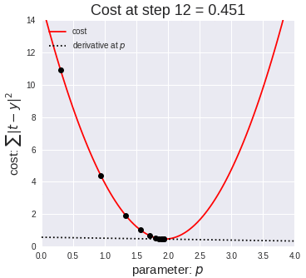

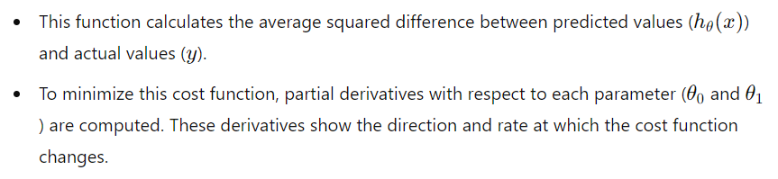
Gradient Descent
Purpose of Gradient Descent
Cost Function and Partial Derivatives
The cost function used in Gradient Descent is the Mean Squared Error (MSE), represented as:

Slide 23
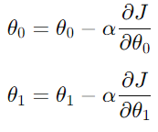
Parameter Update Rules
Gradient Descent iteratively adjusts the parameters using the following update rules:
Here, 𝛼 represents the learning rate, a small positive value that controls the size of each step taken in the opposite direction of the gradient to reach the minimum cost.

Slide 24
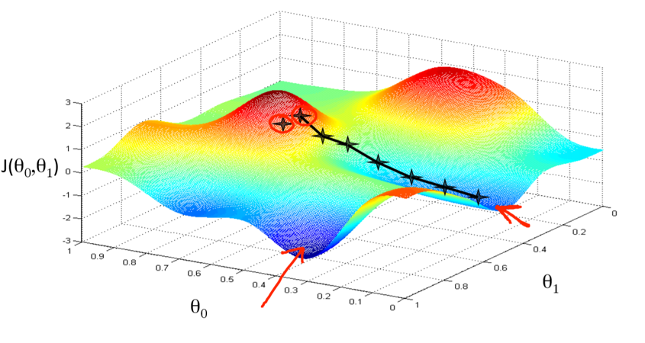
Gradient Descent

Slide 25
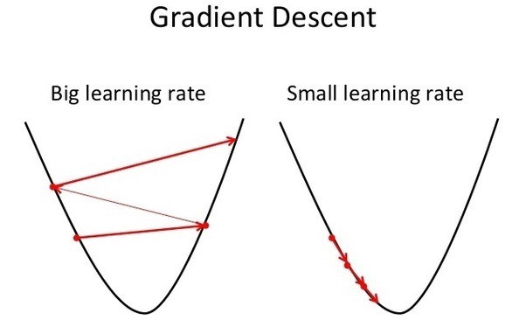
Gradient Descent Iterative Process
1. Finding Global Minimum
The objective of Gradient Descent is to achieve the global minimum of the cost function. During each iteration, parameters are updated based on the computed gradient, guiding the process toward the lowest point on the cost function curve.
2. Effect of Learning Rate (α)
The learning rate controls the size of the steps taken toward the minimum. A small learning rate leads to slow convergence, while a large learning rate might cause overshooting or fluctuation around the minimum.
Experimentation is usually necessary to determine an optimal learning rate that achieves stable and efficient convergence.

